Slide 1
EE4007 - OPTICAL ELECTRONICS
January 2010
© Alan P. Morrison
Lecture 2 - Optical Communications Systems

Slide 2

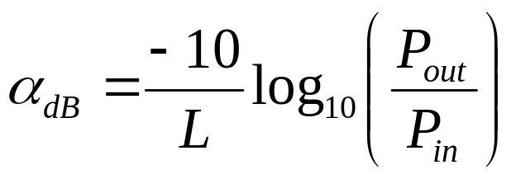
EFFECTS OF ATTENUATION
January 2010
P_{in} input to a fibre of length, L, the optical power at the fibre output =>
α = attenuation constant of the fibre, for waveguides this is normally expressed in cm⁻¹, however, for long fibre links it is expressed in dB/km
© Alan P. Morrison

Slide 3
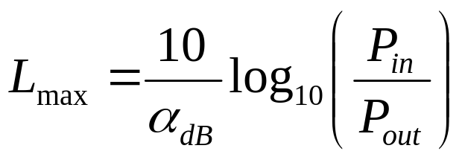
MAX. LENGTH OF FIBRE LINK
January 2010
From the previous expression, if we assume (i) 0 dB link margin (ii) No coupling loss, (iii) receiver sensitivity = P_{out} and (iv) fibre attenuation = α dB/km then the maximum length a fibre system can have is:
NB - factor of 10 reduction in fibre loss => factor of 10 increase in link length; factor of 10 increase in transmitter power OR a factor of 10 improvement in receiver sensitivity => only 33% increase in link length.
© Alan P. Morrison

Slide 4
SPECIFYING DIGITAL SYSTEM RECEIVER’S PERFORMANCE
January 2010
Primary measure => probability that receiver will make an incorrect decision, resulting in a bit-error.
In a digital receiver, the amount of optical signal power needed to obtain the desired bit-error rate is specified.
See next slide for plot of BER vs. receiver optical power….
1. Low-levels of received power => BER high
2. As received power increases the BER reduces
3. Correct design allows quality of service to be achieved at particular BER
4. BER floor - independent of received power, due to receiver degradations
© Alan P. Morrison

Slide 5
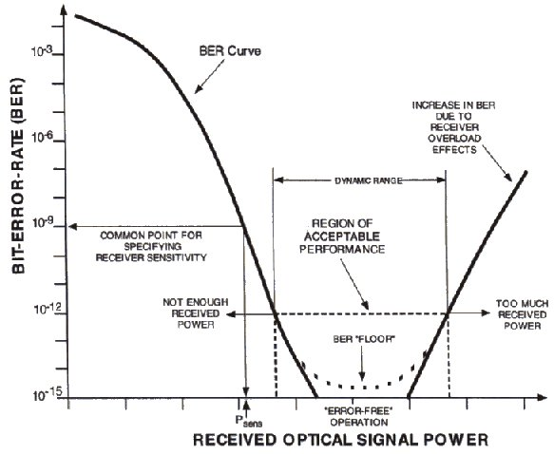
BER VS. RECEIVED OPTICAL POWER
January 2010
© Alan P. Morrison

Slide 6
RECEIVER SENSITIVITY
January 2010
Receiver sensitivity is a function of data rate and wavelength (λ) and can be specified two ways:
(i) dBm - the most common specification
(ii) photons per bit - this is sometimes preferred because it is wavelength and data-rate independent
We need to examine the relationship between the average power and the number of photons/bit.
© Alan P. Morrison

Slide 7
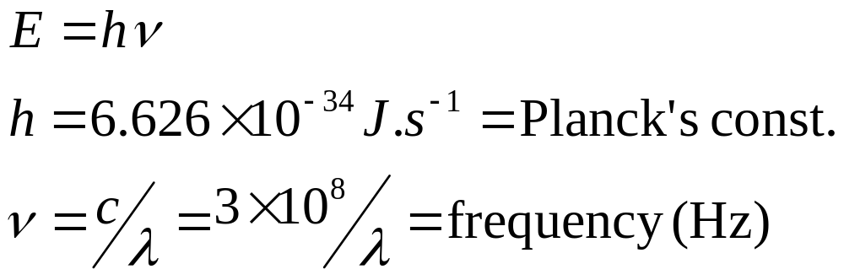
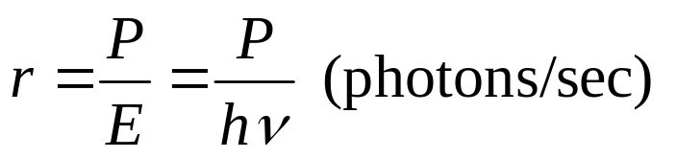
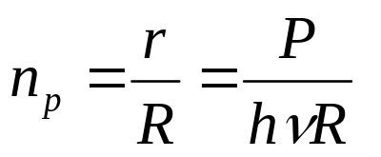
AVERAGE POWER <=> PHOTONS/BIT
January 2010
Photon arrival rate
© Alan P. Morrison
P = average received optical power (Watts)
Photons per bit
R = data rate in bits/s

Slide 8
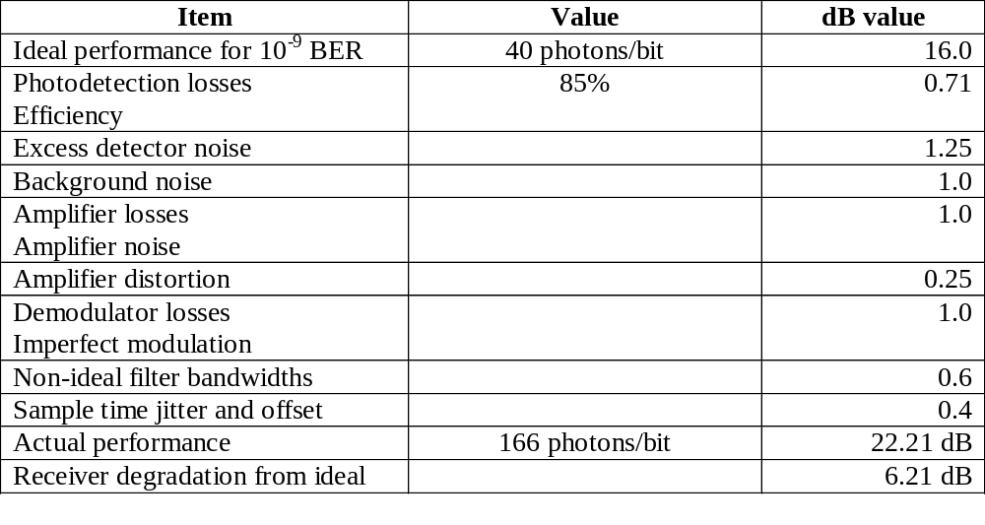
RECEIVER SENSITIVITY BUDGET
January 2010
© Alan P. Morrison
In the above example the dB value was calculated, knowing the data rate and λ. EXERCISE: if λ = 1.55μm what is the data rate?

Slide 9
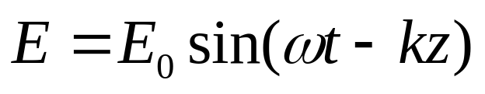
FUNDAMENTALS OF LIGHTWAVE PROPAGATION
January 2010
Light - electromagnetic wave, oscillating electric and magnetic fields
Wavelength, period, wavenumber, frequency
Electric field,
k is propagation factor =
v is phase velocity of wave
© Alan P. Morrison

Slide 10
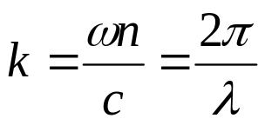
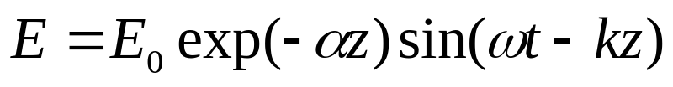
FUNDAMENTALS OF LIGHTWAVE PROPAGATION
January 2010
Velocity, v = c/n
Propagation constant in free space is k₀
Wavelength in a medium is shorter than in free space, because n > 1.
To correct for attenuation:
© Alan P. Morrison

Slide 11
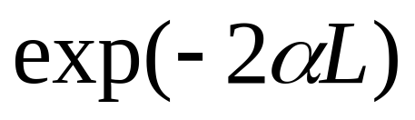
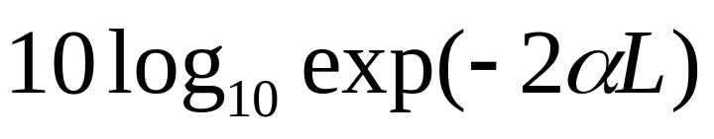
FUNDAMENTALS OF LIGHTWAVE PROPAGATION
January 2010
The attenuation constant determines rate at which electric field diminishes with distance
Intensity of a light beam is proportional to square of the electric field => for a path length, L, the ratio of the output power to input power is:
Power reduction in dB is:
© Alan P. Morrison

Slide 12
FUNDAMENTALS OF LIGHTWAVE PROPAGATION
January 2010
Real source -- finite linewidth or spectral width
zero linewidth source is perfectly monochromatic
© Alan P. Morrison

Slide 13
FUNDAMENTALS OF LIGHTWAVE PROPAGATION
January 2010
Small size and low power requirements of LEDs and LDs make them most practical for fibre systems
Spectral linewidth limits information capacity of a fibre system - if limited capacity is greater than capacity required then noncoherence can be ignored
© Alan P. Morrison

Slide 14
FUNDAMENTALS OF LIGHTWAVE PROPAGATION
January 2010
In fibre optics, n, varies with wavelength => wave velocity also varies with wavelength
material dispersion - property of material used
waveguide dispersion - property of structure itself
dispersion leads to pulse broadening, or signal distortion
© Alan P. Morrison

Slide 15
FUNDAMENTALS OF LIGHTWAVE PROPAGATION
January 2010
Need to determine how much broadening is introduced by dispersion and how this relates to the amount of information we can transfer
Let τ be the time for a pulse to travel a path of length L. In a dispersive material a pulse of spectral width Δλ=λ₂−λ₁ will exhibit a difference in travel time per unit length for the two extreme wavelengths
© Alan P. Morrison

Slide 16
FUNDAMENTALS OF LIGHTWAVE PROPAGATION
January 2010
Thus: Δ(τ/L) = (τ/L)₂ - (τ/L)₁ is the pulse spread per unit length. The pulse spread is Δτ.
Pulse width, or duration depends on definition.
Definition we will use is: Pulse duration is the interval from time the optical power rises from half its peak value to the time it falls to half its peak value (FDHM - full duration half maximum)
Take slope of τ/L vs. λ curve.
© Alan P. Morrison

Slide 17
FUNDAMENTALS OF LIGHTWAVE PROPAGATION
January 2010
where M is defined as the material dispersion
© Alan P. Morrison

Slide 18
FUNDAMENTALS OF LIGHTWAVE PROPAGATION
January 2010
Units of M are ps/(nm.km) or picoseconds of pulse spreading per nanometer of source spectral width and per km of path length
When M is positive the longer wavelength in the pulse travels faster, when M is negative the shorter wavelength travels fastest
For pure silica fibres, the material dispersion is zero at a wavelength of 1.3μm
© Alan P. Morrison

Slide 19
FUNDAMENTALS OF LIGHTWAVE PROPAGATION
January 2010
Example 1: Calculate the pulse spreading in pure silica for an LED operating at 820nm, having a 20nm spectral width. Path length is 10km. Repeat for λ=1.5μm and Δλ=50nm.
Solution: For pure silica M=110ps/nm.km at 0.82μm. => pulse spread per length is (110)(20)=2200 ps/km = 2.2 ns/km, so after 10km, the spread is 22 ns.
© Alan P. Morrison

Slide 20
FUNDAMENTALS OF LIGHTWAVE PROPAGATION
January 2010
Changing wavelength to 1.5μm, results in a material dispersion of 15 ps/nm.km. Pulse spreading per unit length is 750 ps/km, => after 10km means the pulse spreading is 7.5 ns => spread is reduced at longer wavelength, even with increased source spectral width.
In previous example, if LED was replaced with LD with 1nm spectral width results in a pulse spread of 1.1 ns at 820 nm, and 0.15 ns at 1.5μm => use of a more coherent source greatly reduces the amount of material dispersion.
© Alan P. Morrison

Slide 21
FUNDAMENTALS OF LIGHTWAVE PROPAGATION
January 2010
Cannot neglect material dispersion even at zero dispersion wavelength in a material
  source will rarely emit at exactly zero dispersion λ
  λ will vary with temperature and drive current
  real source will not be spectrally pure
A maximum permissible pulse spread is usually specified for systems designed around 1300nm
Dispersion curve nearly straight between 1200 and 1600nm
© Alan P. Morrison

